Slide 1
COMPUTER NETWORKS (CS212) LAB 3
Reference to assignment 3

Slide 2

Agenda
Protocols Analysis Using Wireshark
Analyzing TCP Handshaking Using Wireshark
Analyzing sequence of messages with example
Analyzing statistics using wireshark

Slide 3
Protocols analysis using wireshark

Slide 4
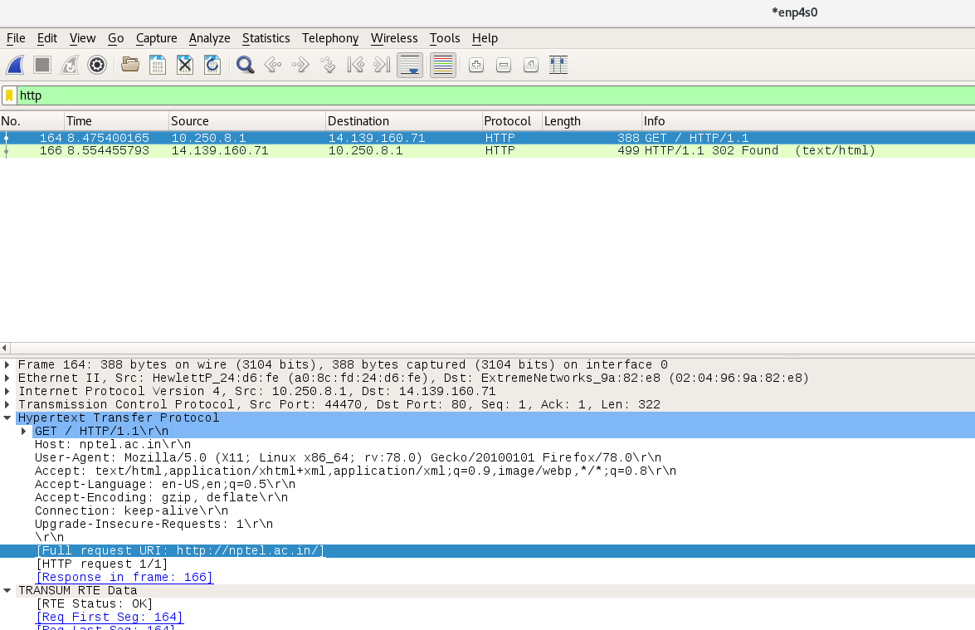
Http
Started capturing packets in wireshark.
Accessed the URL http://nptel.ac.in/ (without https)
Stopped capturing packets in wireshark.

Slide 5
Http ( continued)
Packet 1
Source to destination - local machine to nptel server. (10.250.8.1 to 14.139.160.71)
HTTP Get Request - The GET method is used to retrieve information from the given server using a given URI.
Packet 2
Source to destination - nptel server to local machine. (14.139.160.71 to 10.250.8.1)
HTTP status code 302 found - It indicates the URL redirection.
Note : If the requested HTML page is not found , then HTTP 404 status code is returned.

Slide 6
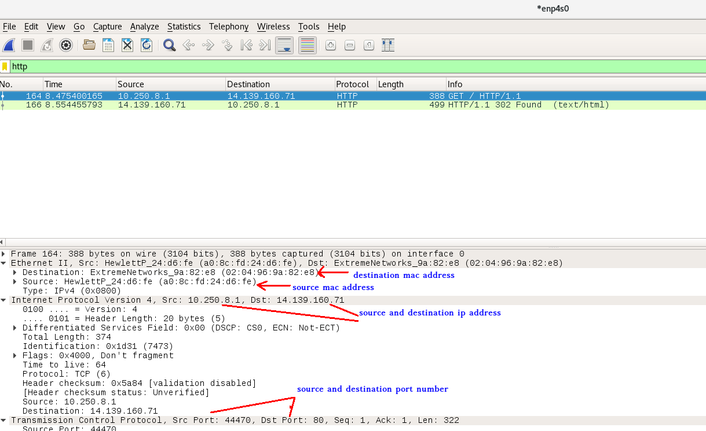
Http (continued)

Slide 7
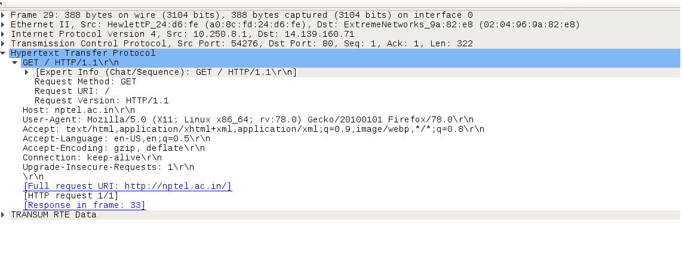
Http Packet Analysis

Slide 8
Http Packet Analysis ( Continued )
Request Method: GET ==> The packet is a HTTP GET .
Request URI: / ==> The client is looking for the requested website.
Request version: HTTP/1.1 ==> It’s HTTP version 1.1
Accept: text/html, application/xhtml+xml, image/jxr, */* ==> Tells server about the type of file it [client side browser] can accept. Here the client is expecting alice.txt which is text type.
Accept-Language: en-US ==> Accepted language standard.
User-Agent: Mozilla/5.0 (Windows NT 10.0; WOW64; Trident/7.0; rv:11.0) like Gecko ==> Client side browser type. Even if we used internet explorer but we see it always/maximum time says Mozilla
Accept-Encoding: gzip, deflate ==> Accepted encoding in client side.
Host: nptel.ac.in/==> This is the web server name where client is sending HTTP GET request.
Connection: Keep-Alive ==> Connection controls whether the network connection stays open after the current transaction finishes. Connection type is keep alive.

Slide 9
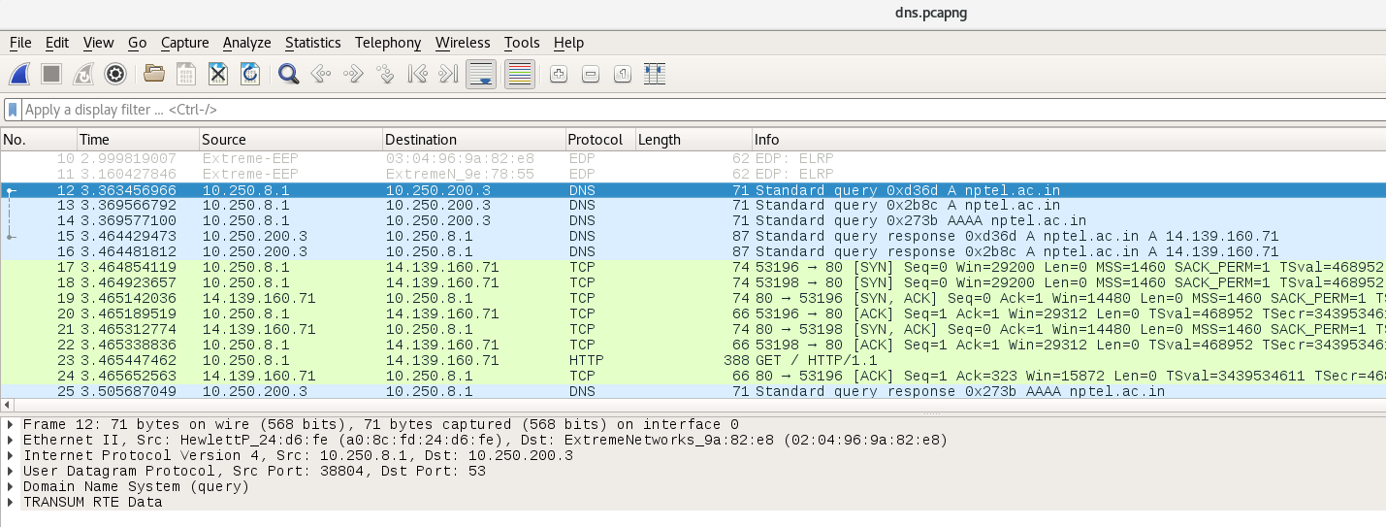
2. DNS
DNS is used to map domain name to ip address.
Here the dns is used to find ip address of nptel server

Slide 10
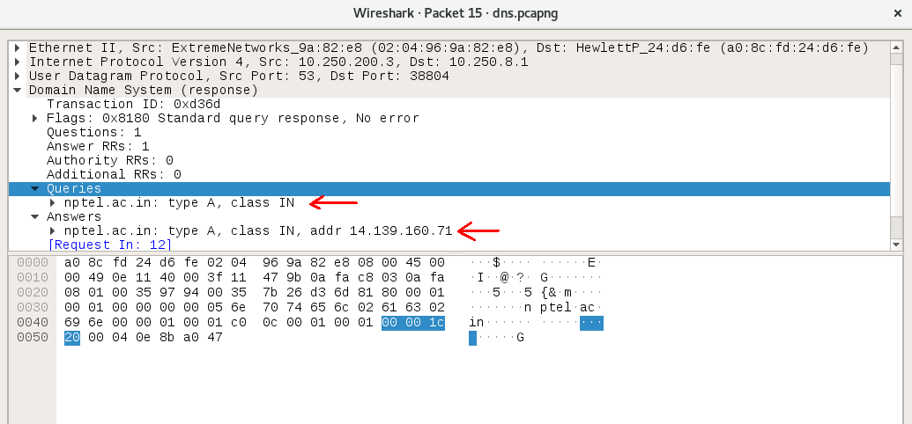
DNS Packet Analysis

Slide 11
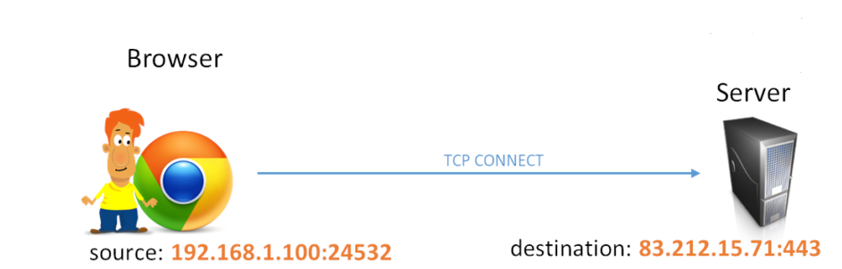
3. TCP
Transmission Control Protocol (TCP) – a connection-oriented communications protocol that facilitates the exchange of messages between computing devices in a network.

Slide 12
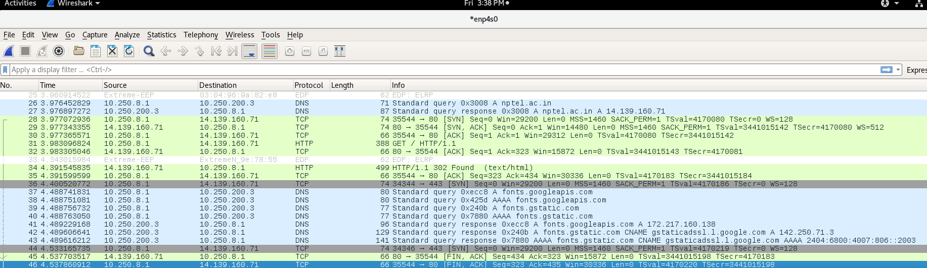
TCP Packet Analyzing

Slide 13
The generic TCP parameters on each packet are:
Source port : The port number of the side who transmitted this packet
Destination port : The port number of the side who should receive this packet
Stream index : This is not a real TCP parameter. It’s only a Wireshark representation of the connection 4 values (source address, source port, destination address, and destination port).
TCP segment length: The size of the data contained on this packet.
Sequence number: This is a Wireshark more readable representation of the sequence number. It’s calculated starting from 0, so it’s easier to track packets.
Sequence number (raw): The actual sequence number sent on the packet — the one starts from the ISN

Slide 14
Next sequence number: Normally it’s the current sequence number + the length of data in the current packet.
Acknowledgment number: This represents the total number of bytes the current transmitting host received from the other side.
Acknowledgment number (raw): The real Acknowledgment number.
Header length: The TCP header length. This can range from 20 to 60 bytes depending on the TCP options in the packet.
Window size value: This is the receive buffer size in the current transmitting host. The host here is informing the other side host how many bytes it can receive to avoid the case of the other side replying with a large number of bytes that can’t be handled.
Checksum: Checksum of the TCP packet. This is used by the receiving host to verify that the received packet is OK.

Slide 15
TCP Handshaking
THREE-WAY HANDSHAKE or a TCP 3-way handshake is a process which is used in a TCP/IP network to make a connection between the server and client. It is a three-step process that requires both the client and server to exchange synchronization and acknowledgment packets before the real data communication process starts.
TCP utilizes a number of flags, or 1-bit boolean fields, in its header to control the state of a connection. The three we're most interested in here are:
SYN - (Synchronize) Initiates a connection
FIN - (Final) Cleanly terminates a connection
ACK - Acknowledges received data

Slide 16
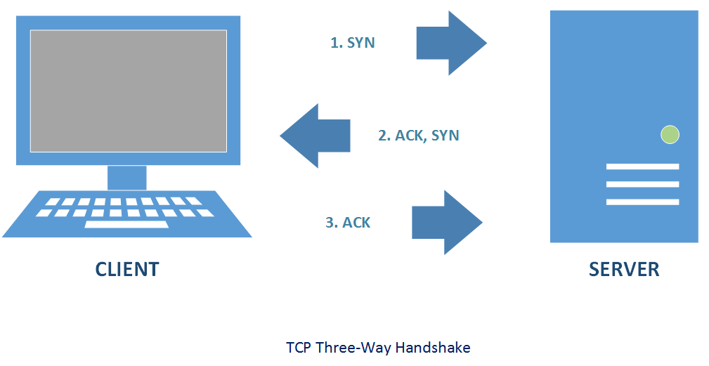
TCP Handshaking (Continued)

Slide 17
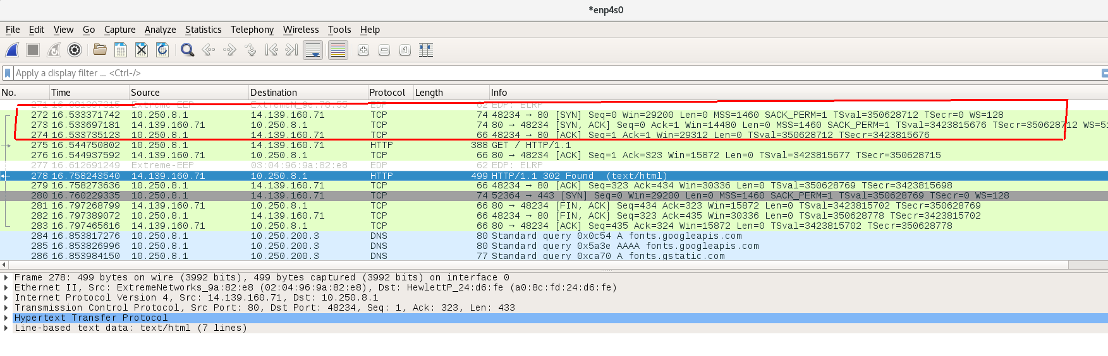
TCP Handshaking (Continued)

Slide 18
4. TLS
Transport Layer Security, or TLS, is a widely adopted security protocol designed to facilitate privacy and data security for communications over the Internet. A primary use case of TLS is encrypting the communication between web applications and servers, such as web browsers loading a website. TLS can also be used to encrypt other communications such as email, messaging, and voice
TLS HANDSHAKING
A TLS handshake takes place whenever a user navigates to a website over HTTPS and the browser first begins to query the website's origin server.TLS handshakes occur after a TCP connection has been opened via a TCP handshake.

Slide 19
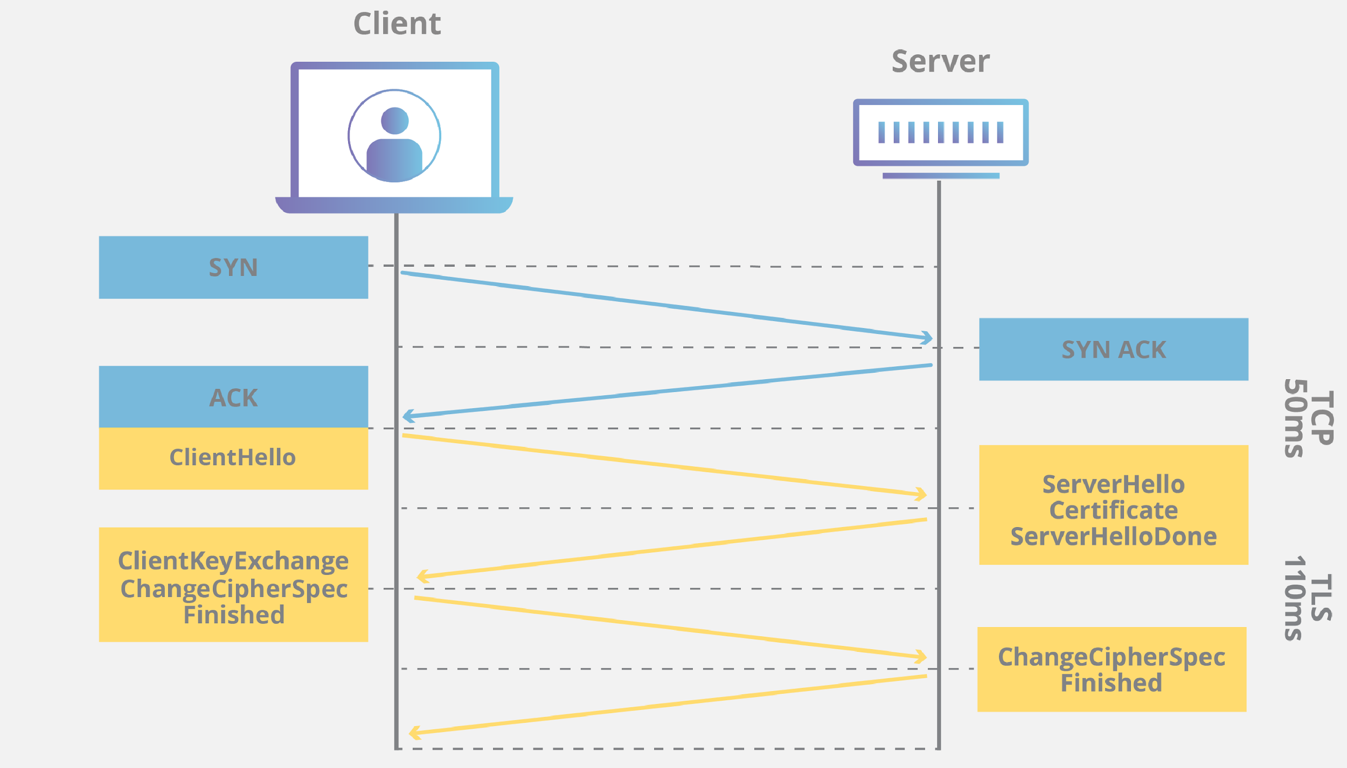
TLS Handshaking

Slide 20
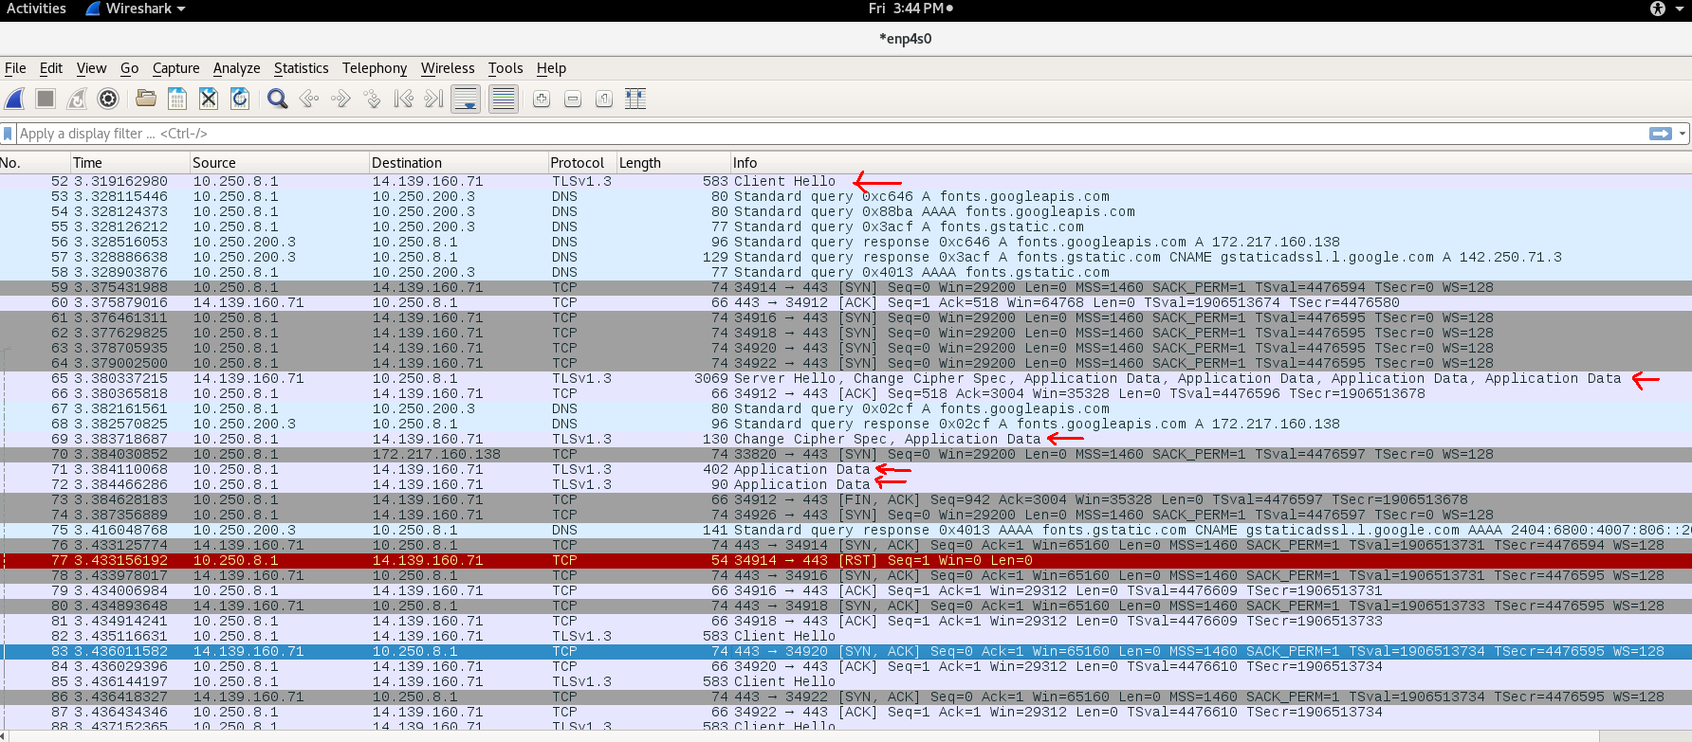
TLS PACKETS

Slide 21
5. UDP
The User Datagram Protocol, or UDP, is a communication protocol used across the Internet for especially time-sensitive transmissions such as video playback or DNS lookups. It speeds up communications by not formally establishing a connection before data is transferred. This allows data to be transferred very quickly, but it can also cause packets to become lost in transit

Slide 22
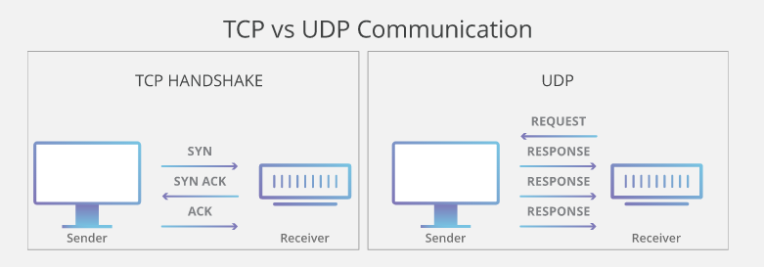

Slide 23
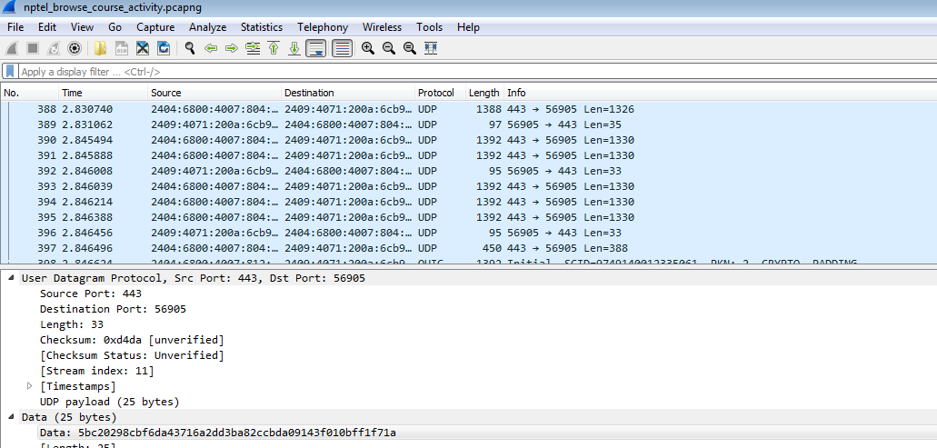
UDP Packet Analysis

Slide 24
UDP Packet Format
Source Port : Source Port is 2 Byte long field used to identify port number of source.
Destination Port : It is 2 Byte long field, used to identify the port of destined packet.
Length : Length is the length of UDP including header and the data. It is 16-bits field.
Checksum - This field ensures if the packet is transmitted correctly or if there is any corruption of packet over network.Unlike TCP checksum calculation is not mandatory in UDP.

Slide 25
Analysis of sequence of messages
Example - NPTEL Website

Slide 26
We have taken example with NPTEL website for analyzing the packets from the traces got from the NPTEL website.Then we will be doing activities like view course list, view videos, etc.

Slide 27
Activity 1 - Browse the website
Start the wireshark capture.
Browse the website without https ( like http://nptel.ac.in)
Stop capturing packets in wireshark.
We will get http and tcp packets from the traces here.

Slide 28
Analysis of HTTP and TCP packets - Activity 1
First a TCP connection is established between source and destination (i.e local machine and nptel server).You will observe syn, syn+ack and ack flags in the three consecutive packets.
Then a HTTP GET request is found in the trace to get the requested URL.
Then source and destination acknowledges each other.
HTTP packet 302 status says about redirection of website URL and it is able to find it.
Then we can see sequence of TCP packets each with sequence number of acknowledgement number.

Slide 29
Activity 2 - Browse the course list
Start the wireshark capture.
We will visit the course list page of nptel website.
Stop wireshark capture.
We will see DNS,TCP and UDP packets from the traces here.

Slide 30
Analysis of Packets - Activity 2
The first few packets has DNS protocol to resolve the domain name to ip address.i.e the document page containing course list is mapped with corresponding address.
Then we see few TCP packets in grey colour which represent TCP packets with flags SYN/FIN.
TCP packets with SACK_PERMITTED represents retransmission of packets if there is packet loss.
TLS Handshaking also happen.
We see some UDP packets where there is no acknowledgement of receipt from the destination and lost packets are not transmitted.

Slide 31
Wireshark Statistics -Throughput,packet loss,RTT,Number of TCP & UDP packets

Slide 32
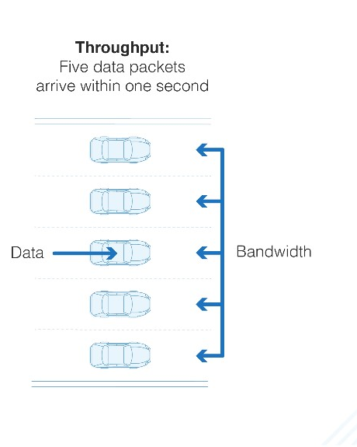
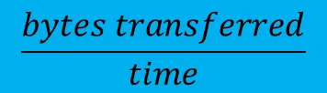
ThroughPut
The network throughput calculation is simply :

Slide 33
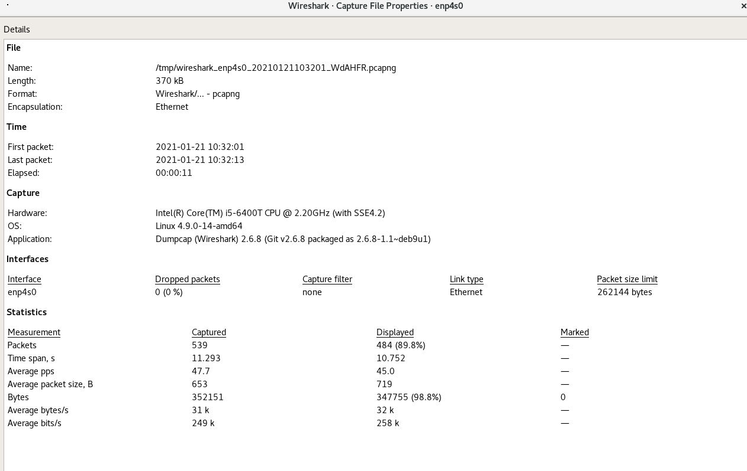
Click on statistics in the top menu of wireshark -> capture file properties
Throughput =
352151/11.293= 31183.12 bytes/sec

Slide 34
Packet Loss Analysis
Case 1 : For TCP
Identify the black coloured packets which represents packet loss.
It represents retransmitted packets or duplicate acknowledged packets.

Slide 35
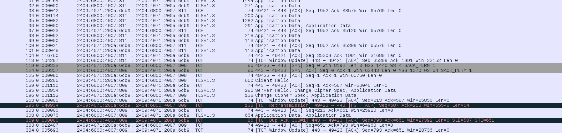

Slide 36
Case 2 : For ICMP
Identify the black coloured packets which represents packet loss.
It represents retransmitted packets or lost packets.
You can also apply filter like icmp.no_resp in the wireshark window.

Slide 37
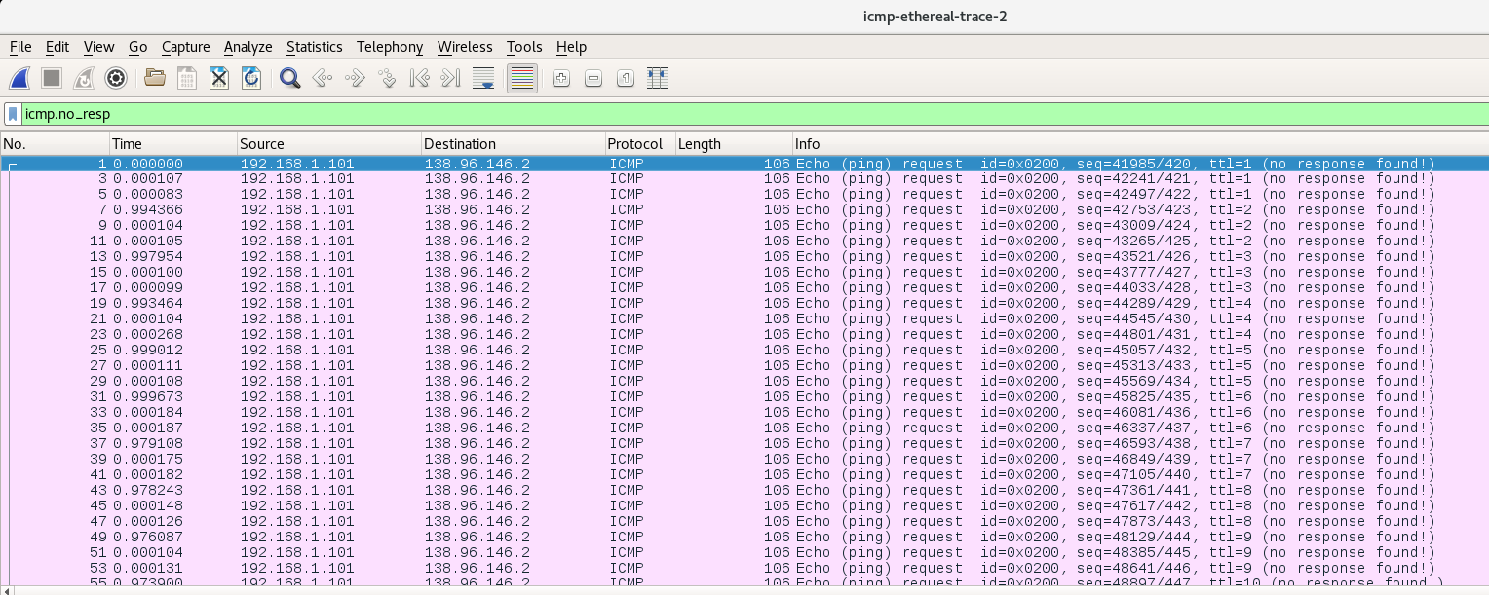

Slide 38
RTT for each packet
Click on view -> Time display format ->
Seconds since previous captured packet

Slide 39
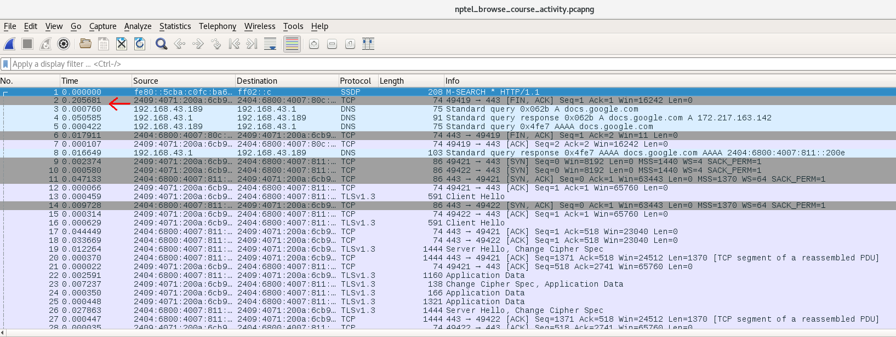

Slide 40
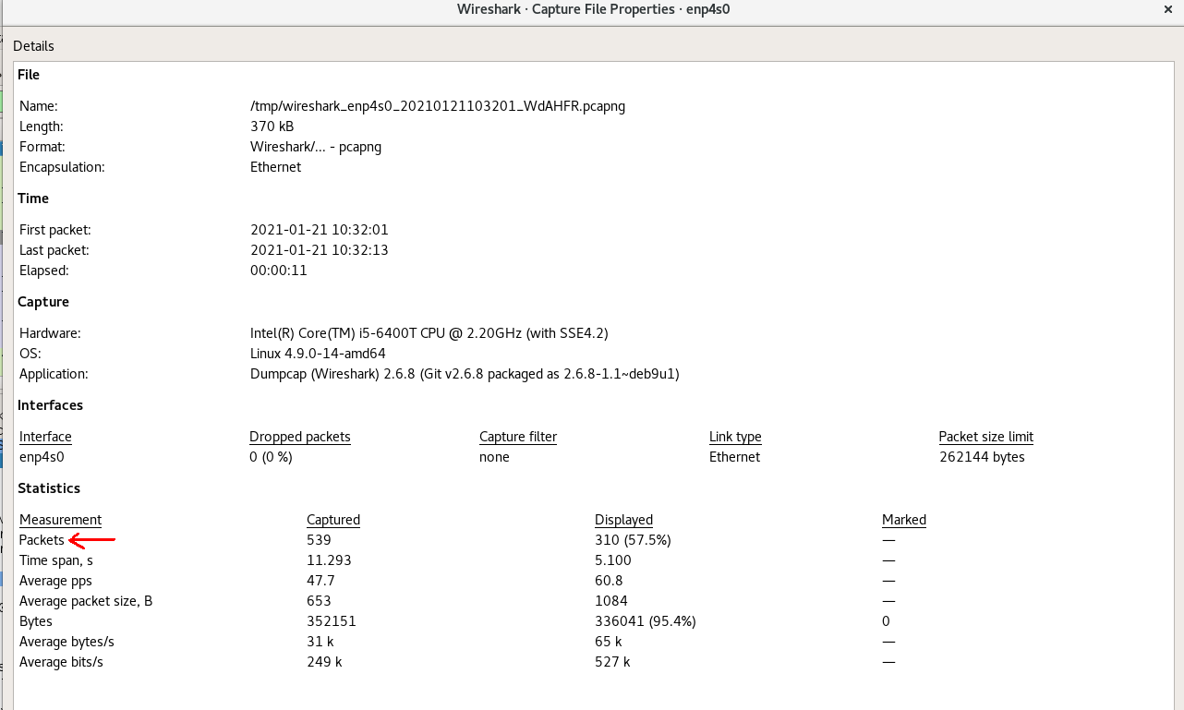
Number of Packets
Go to statistics -> Capture File Properties

Slide 41
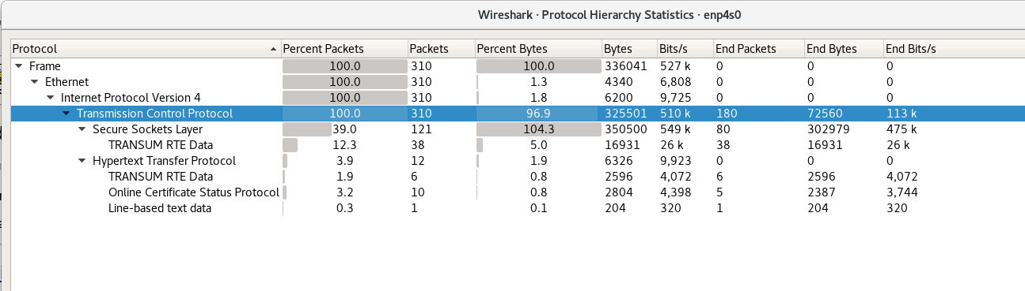

Slide 42
Packet Length
In the wireshark window ,you observe a length column which will give you the length for each packet.You can sort it in ascending or descending order.

Slide 43
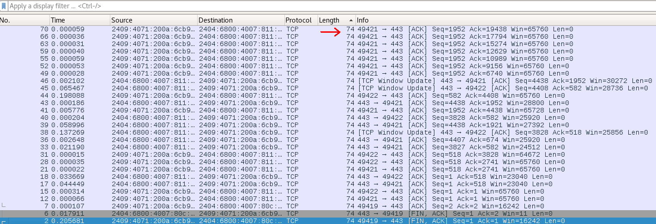

Slide 44
THANK YOU

